Slide 1











CODEWARS V5

Slide 2
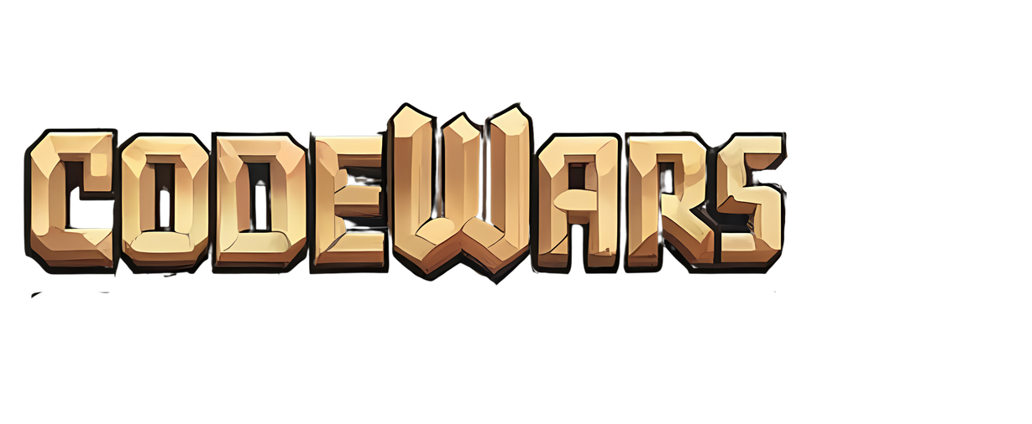
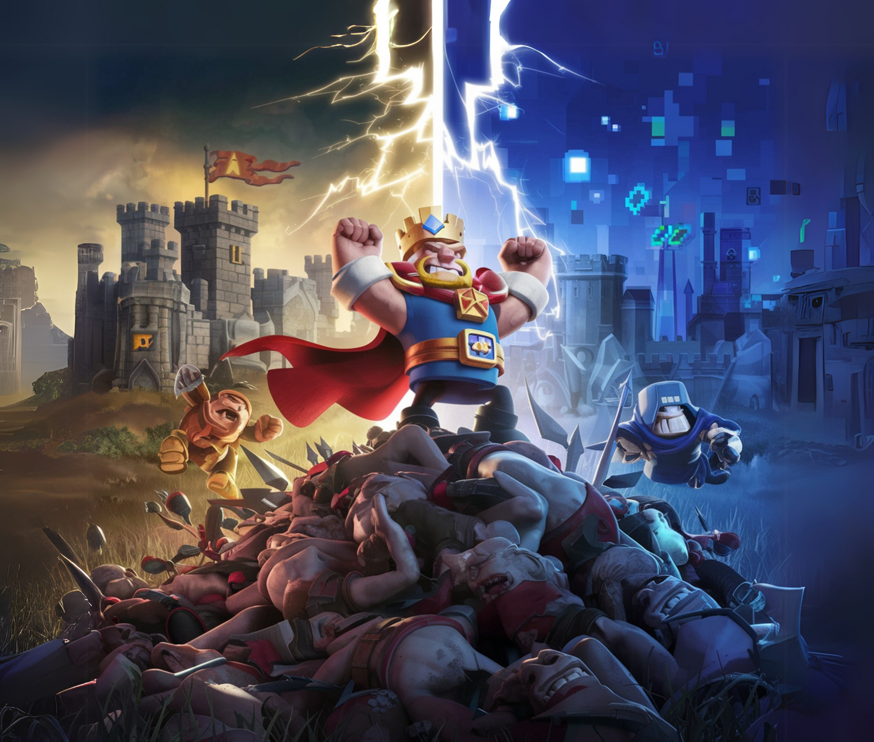





THEME LAUNCH
PRIZES WORTH 50K

Slide 3
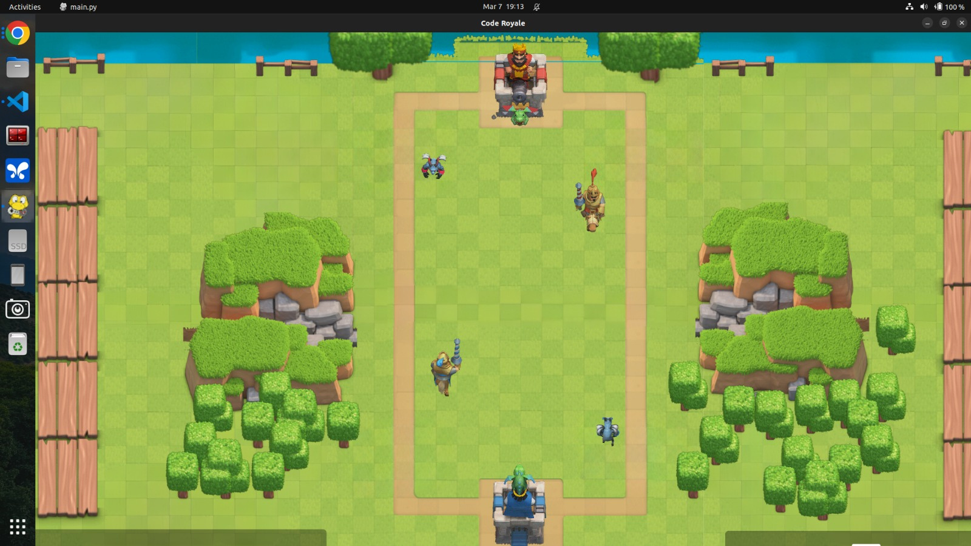


CODE
ROYALE

Slide 4







ABOUT GAME
Ideation
01
~SHRESTH,TUSHAR
The core philosophy of CodeWars has been to gamify the experience of programming for all, irrespective of their experience and familiarity with a certain programming language.
What’s in it ?
02
03
Game structure
04
Interfacing

Slide 5
About:
Code Royale is a 1v1 real-time strategy game where players use a deck of 8 cards to attack their opponent’s towers while defending their own. The main objective is to destroy the opponent before the match ends.
Players deploy troops, using Elixir which is a resource that regenerates over time.
The game ends early if a player destroys the opponent's King Tower.
01
Ideation
What’s in it ?
02
03
Game structure
04
Interfacing

Slide 6
About:
Tower is the static building, that can attack all types of troops, and also acts as a base for launching and controlling the behavior of troops.
Deck Cycle Only 4 out of 8 cards are available for deployment. Once you play a card, it can only be played again after 4 other deployments, i.e one cycle of deployments. The first 4 cards are randomly made available.
Troops are the units that fight, such as:
01
Ideation
What’s in it ?
02
03
Game structure
04
Interfacing

Slide 7
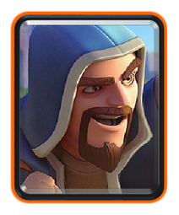
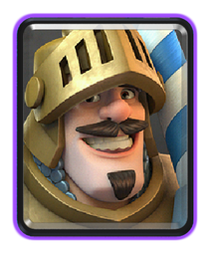
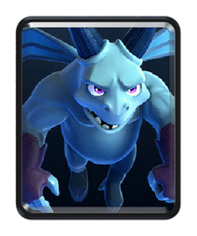

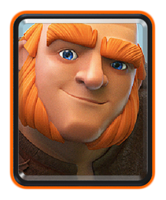

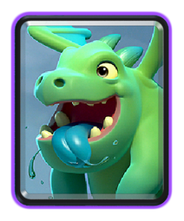
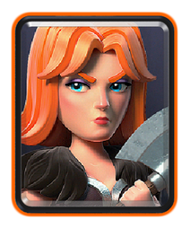
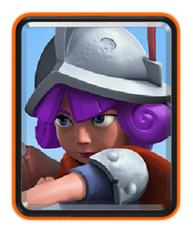
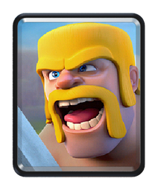


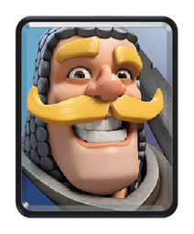
01
Ideation
x5
What’s in it ?
02
x4
03
Game structure
x3
04
Interfacing

Slide 8
PyGame:
Pygame is a free and open-source Python library designed for writing 2D games.
It provides functionalities for handling graphics, sound, input devices, and game physics, making game development more accessible.
Pygame is built on the Simple DirectMedia Layer (SDL), which allows it to run on multiple platforms, including Windows, macOS, and Linux.
01
Ideation
What’s in it ?
02
03
Game structure
04
Interfacing
PyGame Documentation

Slide 9
data/
font/ – contains the fonts used
image_centers/ – Stores image metadata like anchor points.
images/ – Image assets for sprites and game objects.
scripts/ – Contains the core game logic.
01
Ideation
Troops/
assets.py – assigns game assets like images and sprites
config.py – stores game settings and default configurations
dataflow.py – handles state transitions and info access
decoration.py – decorative elements like background & effects
statics.py – contains static elements.
utils.py – utility functions used frequently across the game.
What’s in it ?
02
03
Game structure
Main Game Files:
game.py – The primary game loop and mechanics
main.py – Game entry point, initializing assets
and launching the game.
04
Interfacing

Slide 10
How does your script interact with the game engine ?
01
Ideation
You’ll write your logic code in python file inside the teams directory
You’ll use given helper_functions to deploy troop in the game
Your scripts will be called in the main.py file and another file naming dataflow.py
You can name your scripts anything like destroyer.py but you need to set that name in config.py file before running main.py
What’s in it ?
02
03
Game structure
04
Interfacing

Slide 11
What will you be provided?
01
Ideation
To make any decision in the game, you need to know what’s going on in the arena. The game engine will provide you the data. You’ll be given 4 things.
MyTower: Current health, deployable troops, total elixer, target, game_timer and damaging_power, attack_range, position, size
OppTower: Current health, target, game_timer (same as own)
List of MyTroops
List of OppTroops
What’s in it ?
02
03
Game structure
04
Interfacing

Slide 12
What will you be provided?
01
Ideation
Each Troop of MyTroops: Current position, health, target, uid and damage, size, elixer, type, attack_range, splash_range, target_type
Each Troop of OppTroops: Current position, health, target, uid and damage, size, elixer, type, attack_range, splash_range, target_type
Note: uid is unique for every troop of MyTower and same goes for OppTower. But uid of any of my troop can be equal to uid of any of opp troop. You need to keep track of it.
What’s in it ?
02
03
Game structure
04
Interfacing

Slide 13
What will you write?
01
Ideation
Name of your team
Deck troops (8 unique troops only)
Logic for deployment of troops - when to deploy, what to deploy, where to deploy
You can store limited data of history in your script in a variable team_signal
But you have to follow some rules while deployment.
What’s in it ?
02
03
Game structure
04
Interfacing

Slide 14
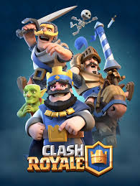

CODE ROYALE IS NOT
CLASH
ROYALE

Slide 15


Slide 16
☠️
DISCLAIMER
This game is not a replica of Clash Royale. It has its own unique mechanics, troop properties, and game play dynamics. Please refer to the provided table for the specific attributes of each troop and apply them accordingly.

Slide 17
Name | Elixir | Health | Damage | Velocity | Type | Attack Range | Splash Range | Attack Speed | Targets
Archer | 3 | 334 | 118 | Medium | Ground | 5 | 0 | Fast | Air/Ground/Building
Minions | 3 | 252 (single) | 129 (single) | Fast | Air | 2 | 0 | Fast | Air/Ground/Building
Knight | 3 | 1938 | 221 | Medium | Ground | 0 | 0 | Medium | Ground/Building
Skeleton (Number =10) | 3 | 89 (single) | 89 (single) | Fast | Ground | 0 | 0 | Fast | Ground/Building
Baby Dragon | 4 | 1267 | 176 | Fast | Air | 3.5 | 1 | Fast | Air/Ground/Building
Valkyrie | 4 | 2097 | 195 | Medium | Ground | 0 | 1 | Fast | Ground/Building
Musketeer | 4 | 792 | 239 | Medium | Ground | 6 | 0 | Medium | Air/Ground/Building
Giant | 5 | 4496 | 186 | Slow | Ground | 0 | 0 | Slow | Building
Prince | 5 | 2112 | 307 | Medium | Ground | 0 | 0 | Medium | Ground/Building
Barbarian (Number=3) | 3 | 736 (single) | 161 (single) | Medium | Ground | 0 | 0 | Medium | Ground/Building
Balloon | 5 | 1848 | 352 | Medium | Air | 0 | 0 | Medium | Building
Wizard | 5 | 1100 | 410 | Medium | Ground | 5.5 | 1 | Fast | Air/Ground/Building

Slide 18

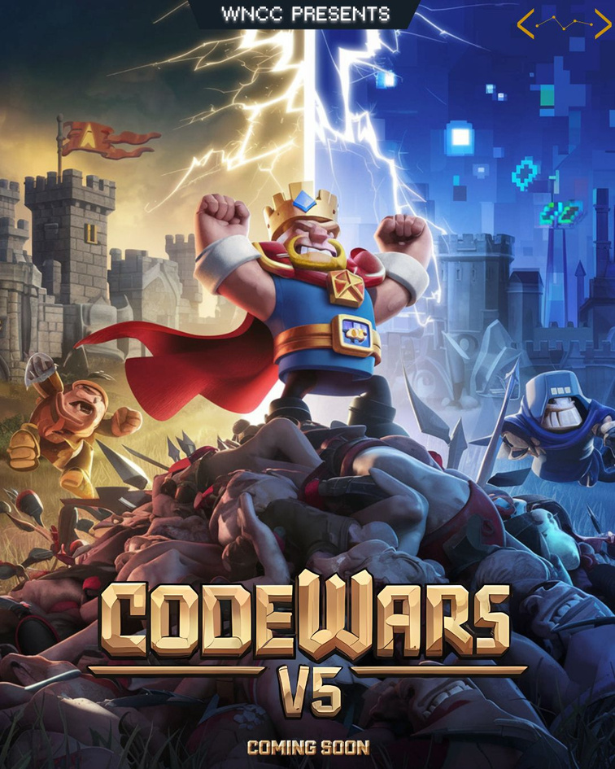
HOW TO PLAY THIS GAME?

Slide 19
GAME RULES
WHAT YOU ARE ALLOWED TO DO:

Slide 20
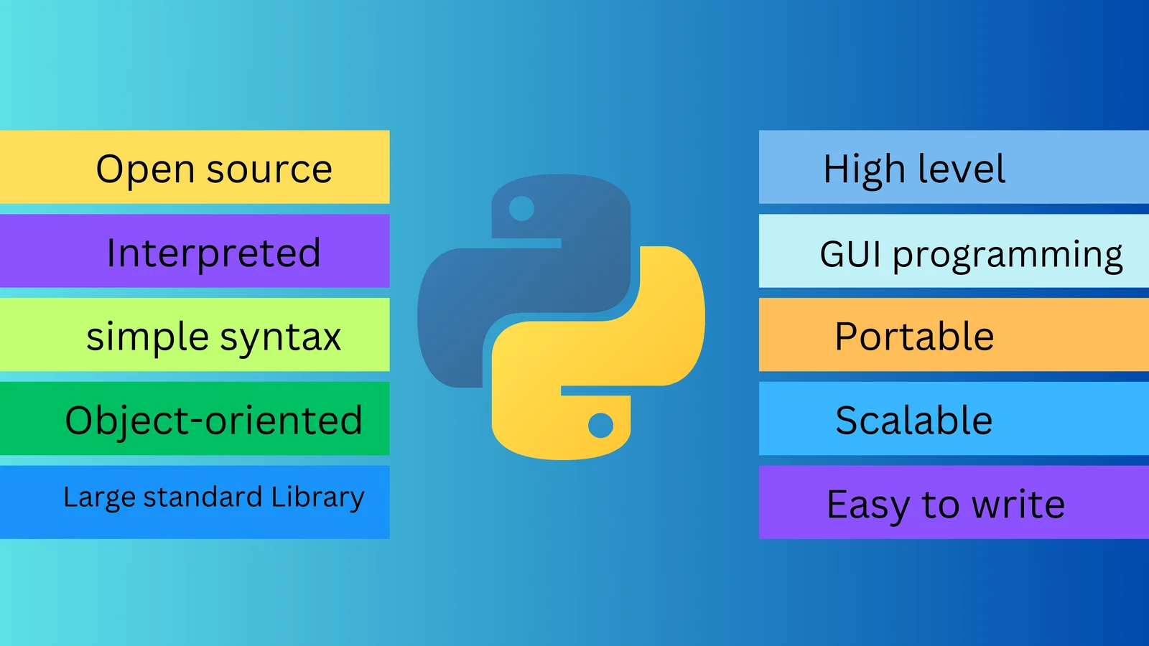
Language U Need to know:
Python

Slide 21
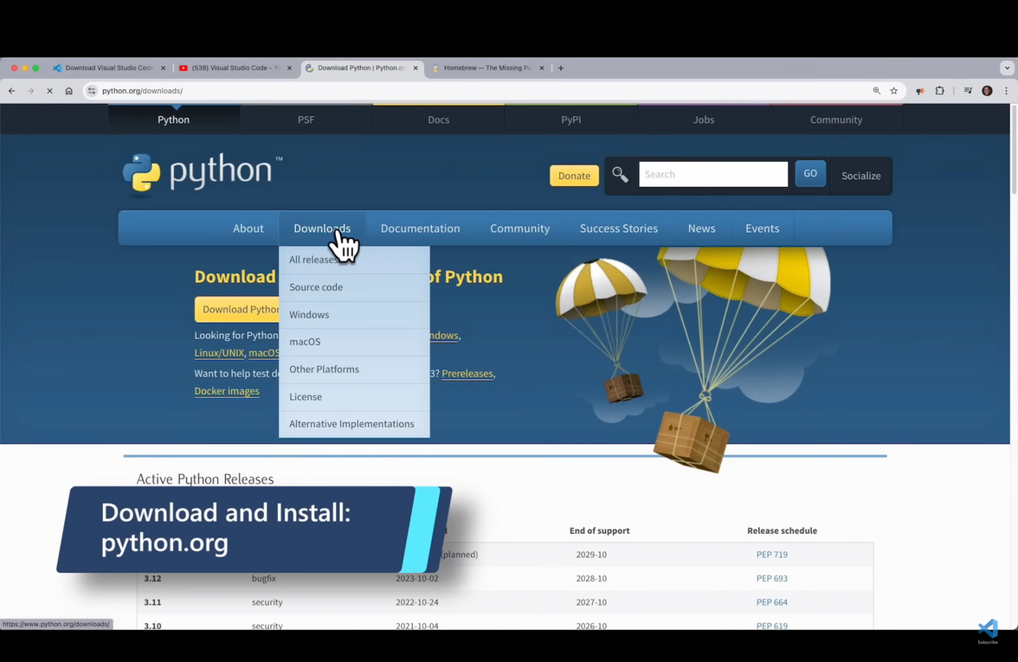
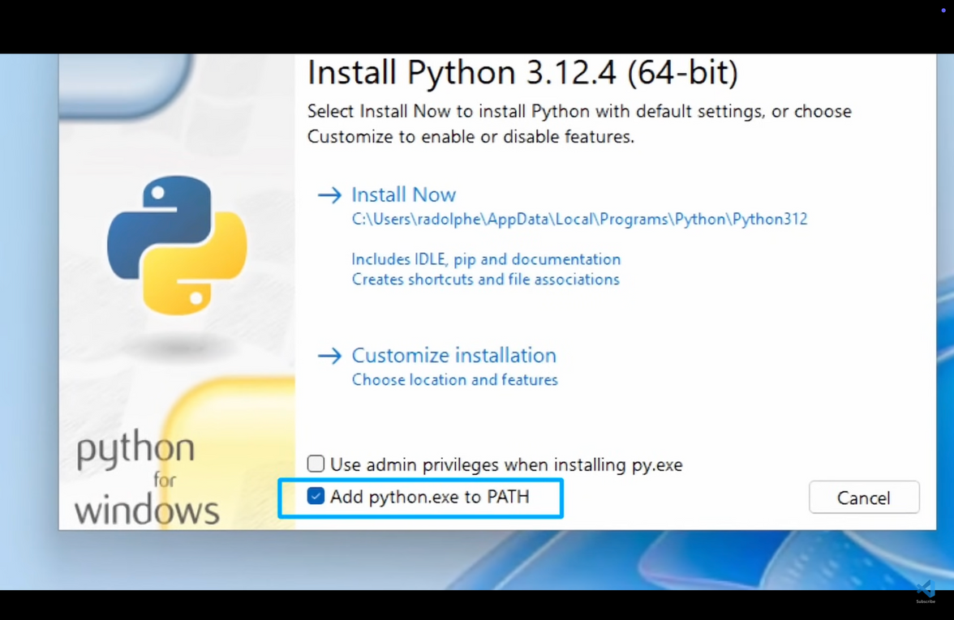
PYTHON INSTALLATION
WINDOWS
Just go to python.org/downloads/ and download the python interpretor for your Windows --->
complete some basic setup steps to get started

Slide 22
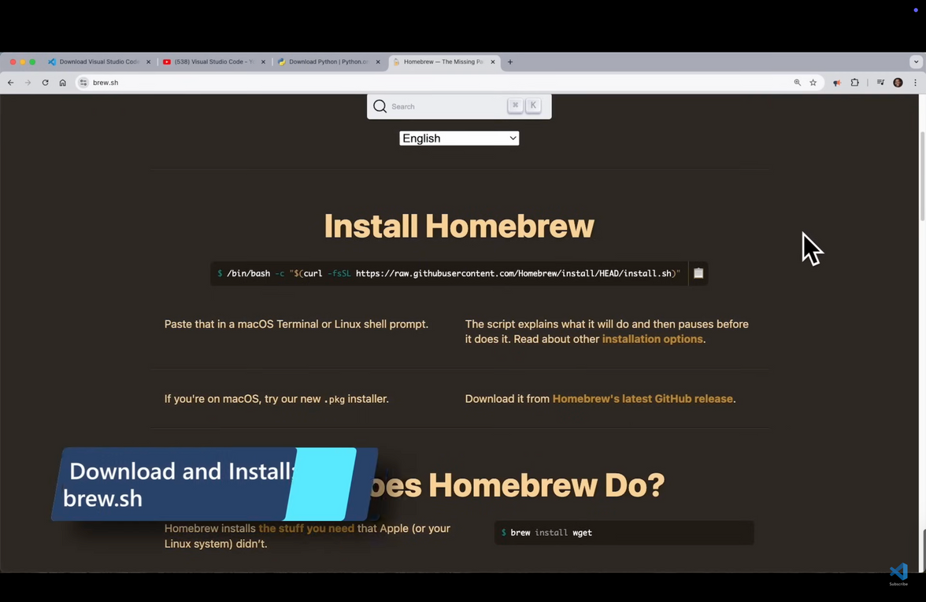
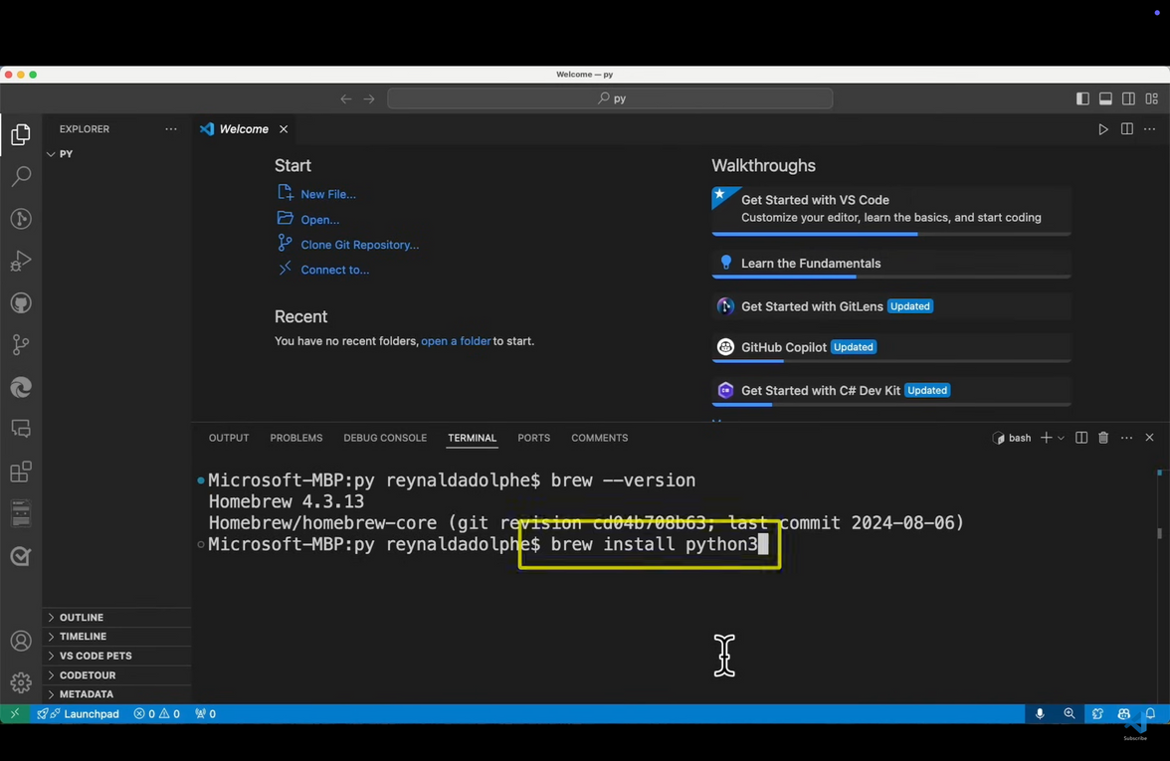
PYTHON INSTALLATION
MAC OS
Just go to brew.sh and download the homebrew for your mac OS using the command below in your terminal
/bin/bash -c "$(curl -fsSL https://raw.githubusercontent.com/Homebrew/install/HEAD/install.sh)"
In your terminal type brew install
python to complete the process

Slide 23
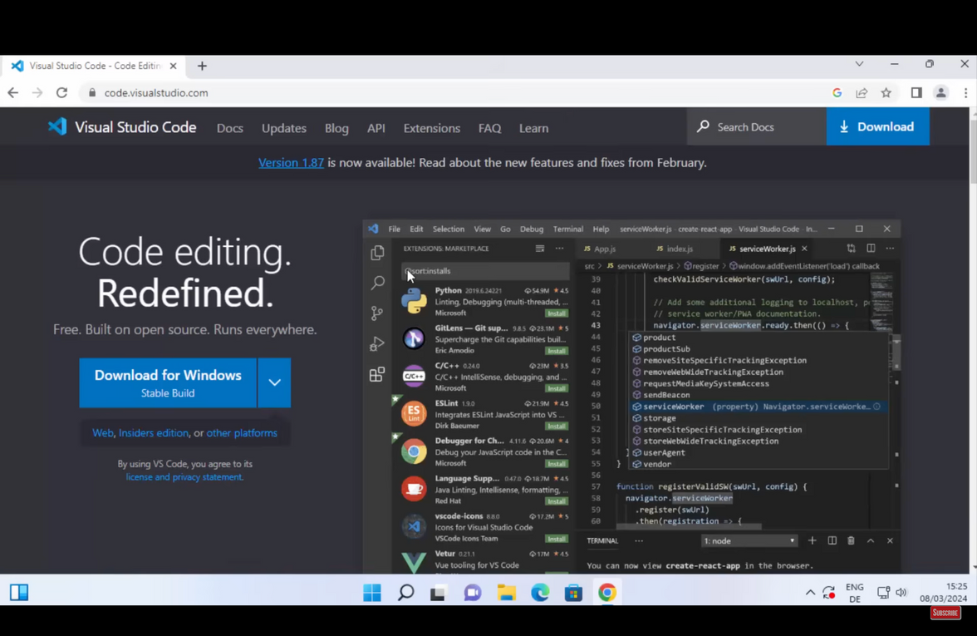
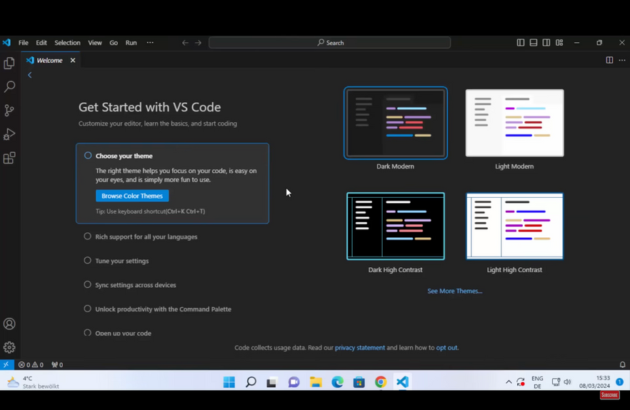
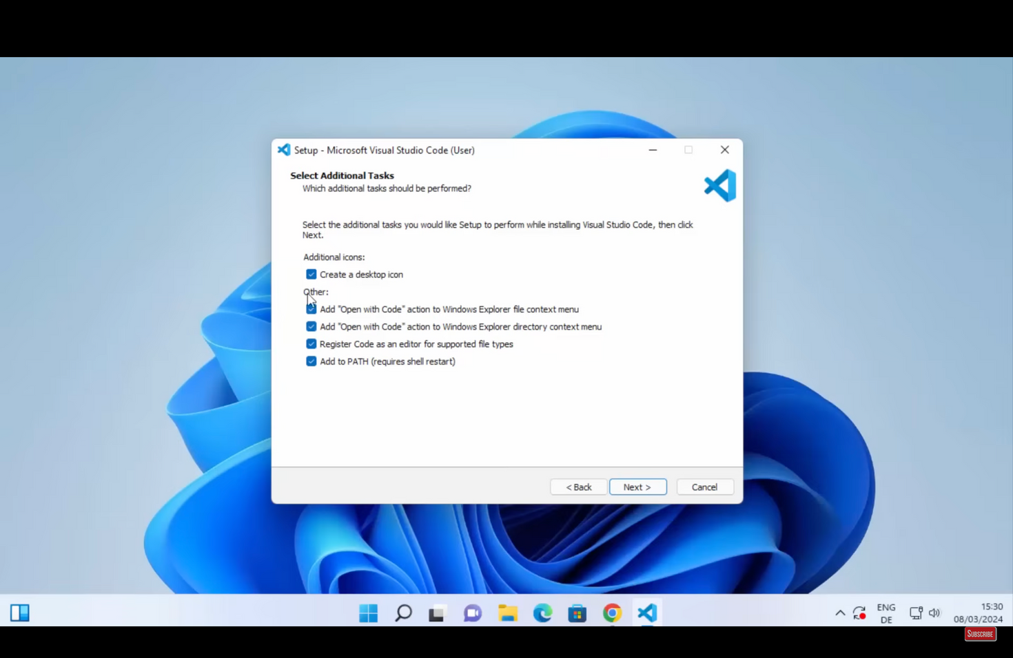
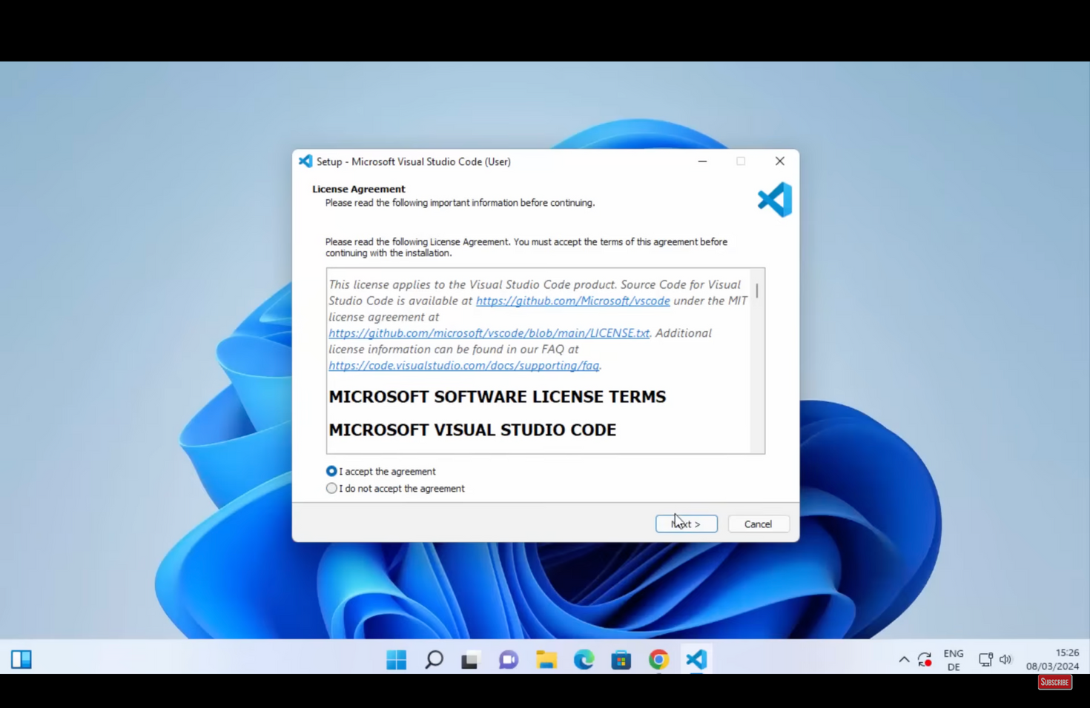
VS CODE
INSTALLATION
Just go to code.visiualstudio.com and download the desktop version for your OS - (windows/ macOS) --->
complete some basic setup steps to get started
If they pop up, just handle them nicely as you do normally

Slide 24

Let’s Get Started!!

Slide 25
VARIABLES
Variables are containers for storing data values
A variable is created the moment you first assign a value to it
x = 5
y = "John"
01
Variables do not need to be declared with any particular type, and can even change type after they have been set.
x = 4 # x is of type int
x = "Sally" # x is now of type str
02
The data type of a variable can be specified with casting
x = str(3) # x will be '3'
y = float(3) # y will be 3.0
z = int(input())
03
PRINT
01
print() function prints the specified message to the screen by
converting it into a string
>>>name = "Alice"
>>>age = 30
>>>print(f"Name: {name}, Age: {age}")
Name: Alice, Age: 30
>>> print("Hello", "how are you?", sep="---")
Hello---how are you?

Slide 26
CONDITIONAL
STATEMENTS
a = 33
b = 200
if b > a:
print("b is greater than a").
An "if statement" is written by using the if keyword
Python relies on indentation (whitespace at the beginning of a line) to define scope in the code instead of brackets
01
elif - if previous conditions were not true, then try this condition
Similarly else can also be used
if b > a:
print("b is greater than a")
elif a == b:
print("a and b are equal")
02
03
The if statements can be nested within each other
if x > 10:
print("Above ten,")
if x > 20 and x<100:
print("Between 20 and 100")

Slide 27
LOOPS
i = 1
while i < 6:
print(i)
if i == 3:
break
i += 1
With the while loop we can execute a set of statements as long as a condition is true
01
The range() function returns a sequence of numbers, starting from 0 by default, and increments by 1 (by default), and ends at a specified number, until specified otherwise
for x in range(2, 30, 5):
print(x)
02
A for loop is also used for iterating over a sequence (that is either a list, a tuple, a dictionary, a set, or a string)
adj = ["red", "big", "tasty"]
for x in adj:
print(x)
03

Slide 28
COLLECTION DATA TYPES
thislist = ["apple", "banana", "cherry"]
list1 = ["abc", 34, True, 40, "male"]
for item in thislist:
print(item)
Lists are used to store multiple items in a single variable
List items can be of any data type, and can contain different data types
01
A list within another list is referred to as a nested list
matrix = [ [1, 2, 3],
[4, 5, 6],
[7, 8, 9] ]
02
Dictionaries are used to store data values in key:value pairs
As dictionaries cannot have two items with the same key, values are basically mapped to keys
thisdict = { "brand": "Ford",
"electric": False,
"year": 1964,
"colors": ["red", "blue"] }
03

Slide 29
FUNCTIONS
def my_function( fname, lname ):
print( fname + " " + lname)
my_function( “Reyansh”, “College”)
In Python a function is defined using the def keyword:
Information can be passed into functions as arguments
01
To let a function return a value, use the return statement:
def my_function(x):
return 5 * x
02
Python also accepts function recursion, which means a defined function can call itself
Be carefull of writing a function which never terminates
def tri_recursion(k):
if(k > 0):
result = k + tri_recursion(k - 1).
print(result)
else:
return 0
03

Slide 30

OOPS

Slide 31
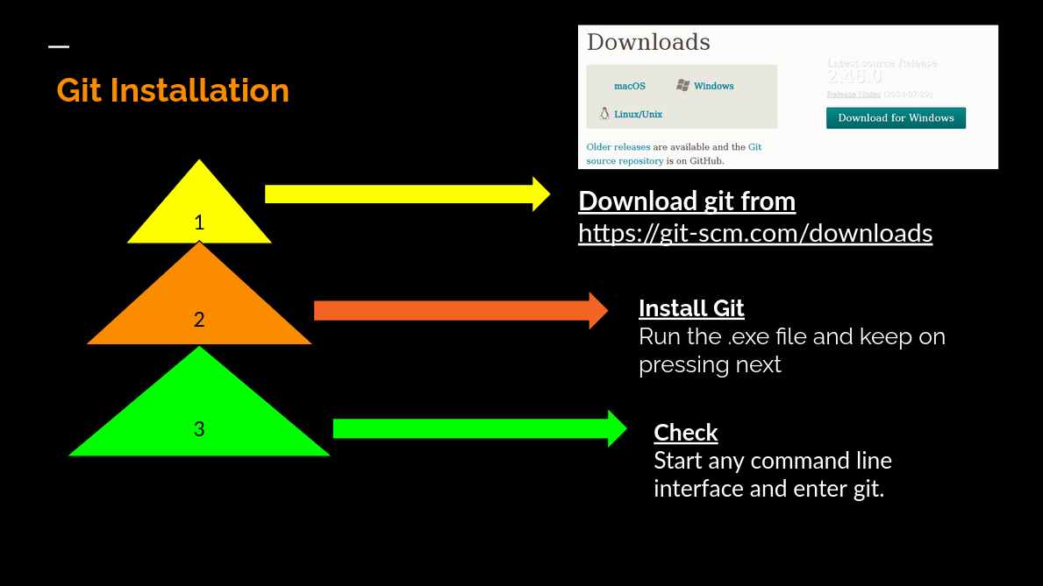

Slide 32
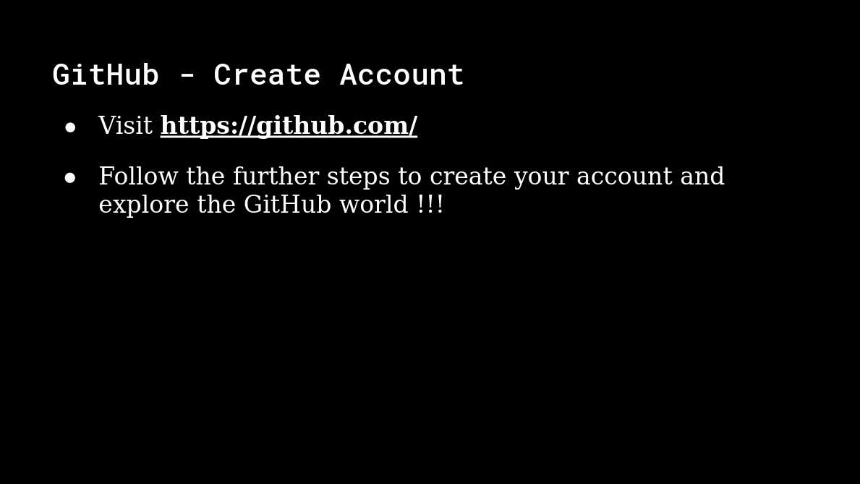

Slide 33
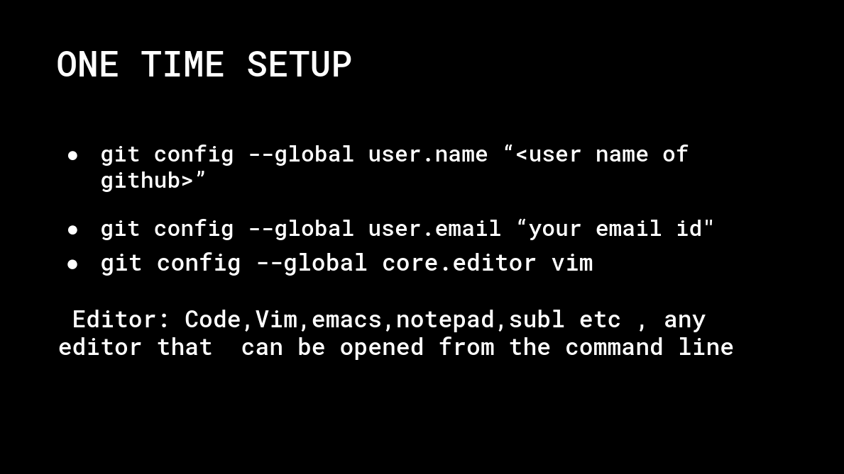

Slide 34
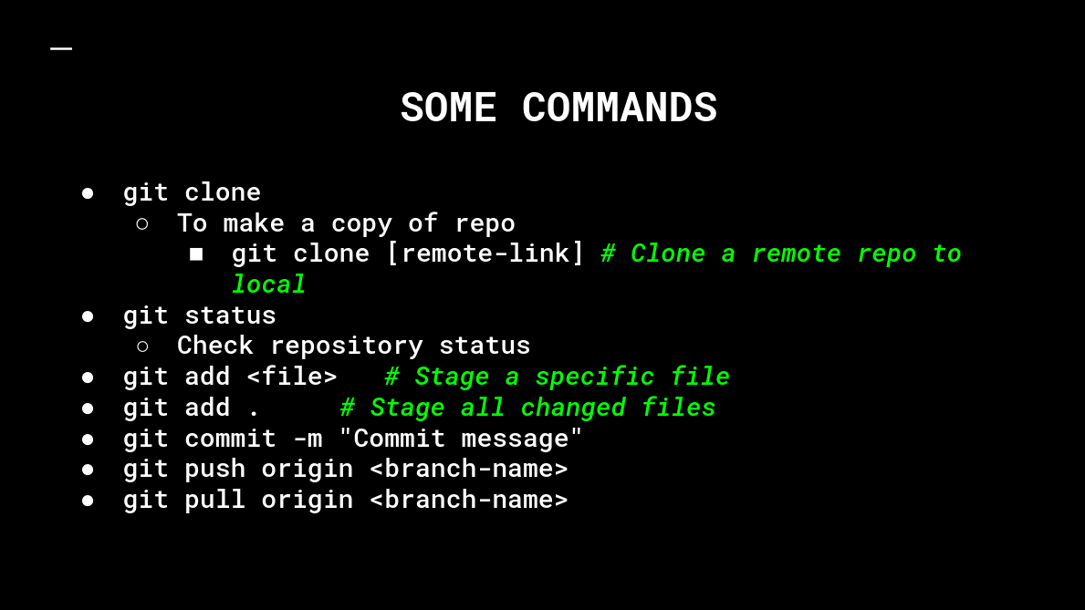

Slide 35
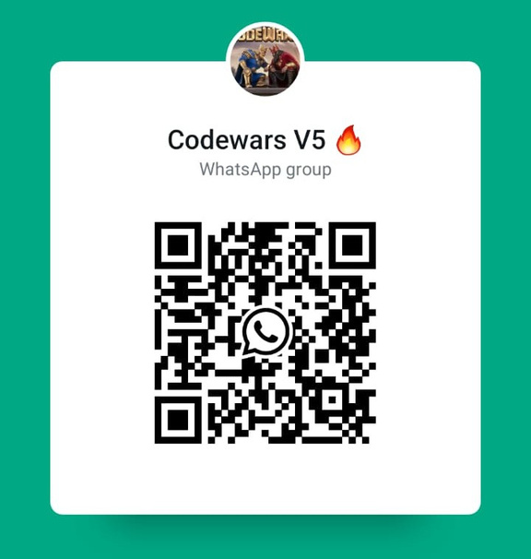



Join the CodeWars Whatsapp group using the QR below:
Mentee Registration Form
Notion Page

